Slide 1


Slide 2

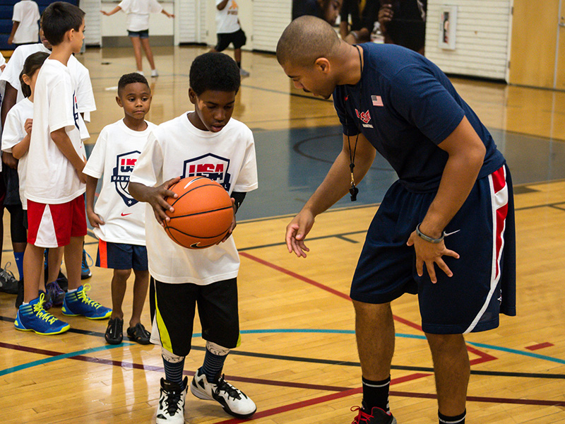
Our Project:
A virtual personal trainer that
Observes the correct movements a user wants to learn
Gives feedback to the user to help them replicate the correct movements whenever they want

Slide 3
Hardware:
Kinect
Provides 3d skeletal point data in the user
2 Micro:Bits
Provides more detailed accelerometer data on certain points on the body

Slide 4
Hardware Difficulties
Feature extraction was a major part of this project, as acquiring meaningful data took a long time.
Wireless Microbits
Kinect while using MacOS
Communication/concatenating data streams

Slide 5
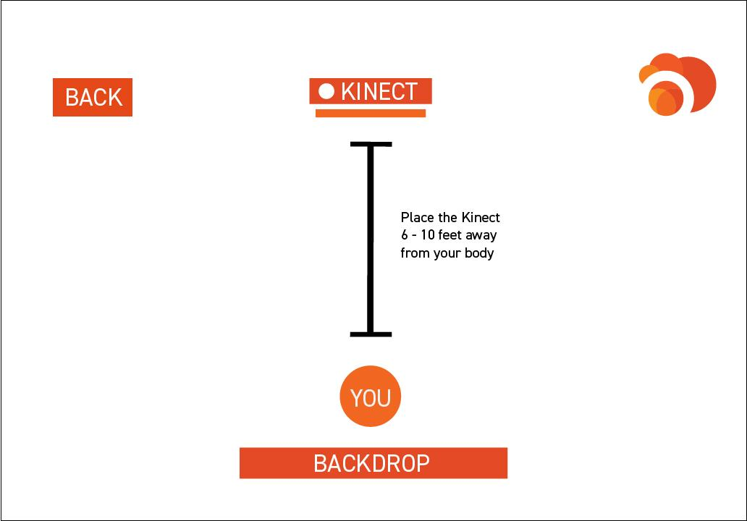

Slide 6
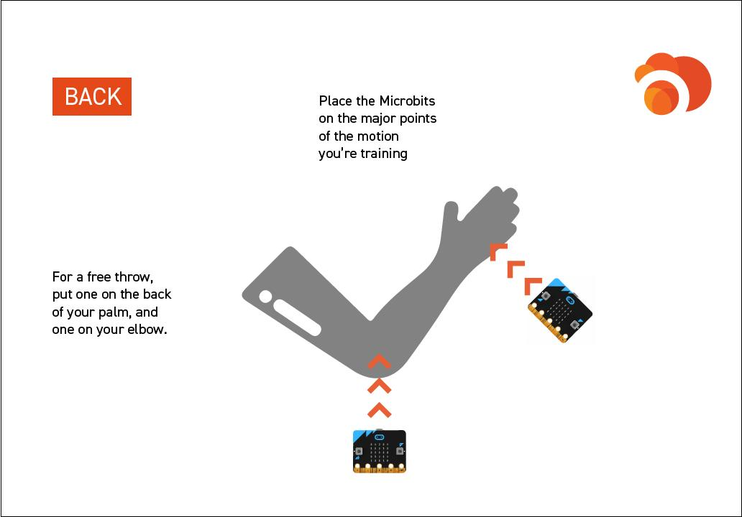

Slide 7



Software:
Processing
Reading and concatenating data from serial port
Python DTW
Dynamic Time Warping Algorithm implemented in Python
PyQt
User Interface

Slide 8
Software Difficulties
In order to accomplish our goals, we needed a more detailed DTW algorithm than wekinator for feedback
Data flow with multiple embedded systems
Creating a software application that had certain needs, i.e. opening up pipes and reading data/stopping

Slide 9
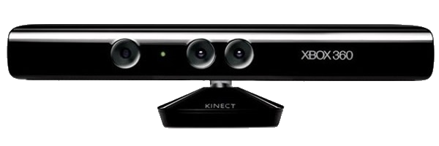
What We Accomplished:
Combine all data received (24 total data points)
18 data points from the Kinect
6 Data points from the Micro:Bits
Use the stream of data with our Python DTW algorithm to identify areas of user improvement
Display the results on our UI

Slide 10
What We Did Not Accomplish:
Work with any motion - did not accomplish this, due to the limit of our hardware
Audio feedback - planned to have a sound indicate whether the user is moving correctly
Database - we wanted to implement persistent storage
Micro:bit holders

Slide 11
Improvements:
Other teams could work on:
Compatibility with any motion
Immediate Feedback
Persistent Storage
Make Micro:Bit Holder

Slide 12
questions?

